Slide 1

Bird call classification: data exploration
Dominik Siric

Slide 2
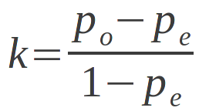
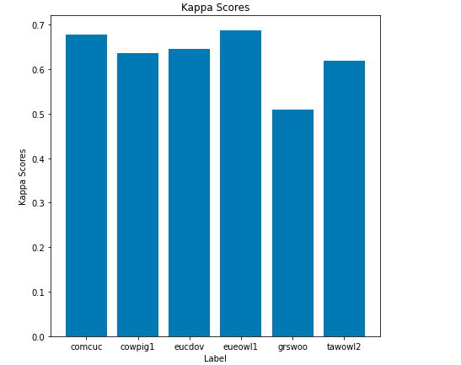
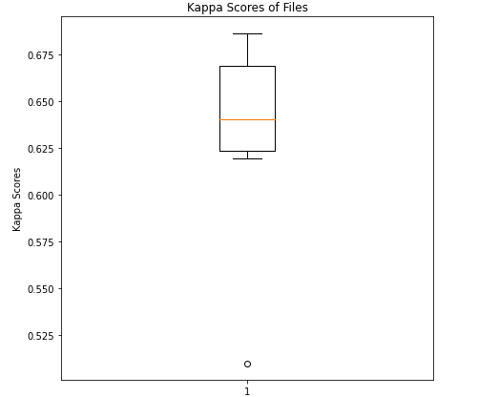
Annotator agreement
Cohen’s kappa coefficient – statistic used to measure inter-rater reliability
In our case it was calculated for each label array of each species first then to get the universal value for each species we took the mean of all values.
In the calculations we only considered the original annotations and calculated the kappa coefficients row by row.
As is visible from the histogram most species have the agreement around the value 0.6 which means moderate level of agreement.
So different annotators in most cases than not agree in their annotations.
There is a slight outlier in the species “grswoo” as seen from the boxplot with agreement coefficient around 0.5

Slide 3
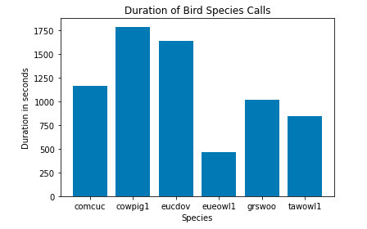
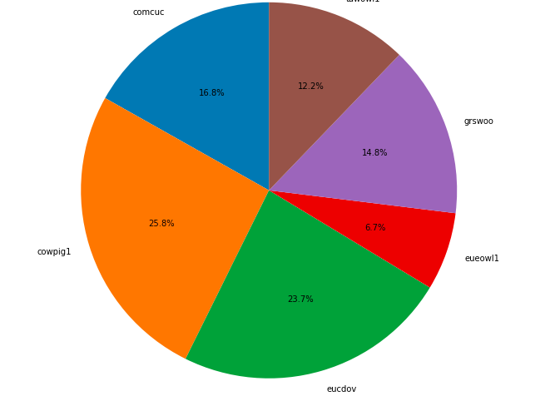
Label characteristic
Class label distribution – calculated by how many times each species was heard by the annotators.
Using only the aggregated labels in the first column which are 0 or non-zero.
From the pie chart its visible that the species “cowpig1” is most dominant while “eueowl1” the least.
The call time was calculated by the number of times the bird was heard times 0.2 seconds which corresponds to the length of the fragment.
The histogram shows how the durations of calls for each species.
Differences between classes are moderate, but quite high between the lowest and the highest class, but the differences within classes also can’t be disregarded since there are many files for one label and it can vary from file to file.

Slide 4
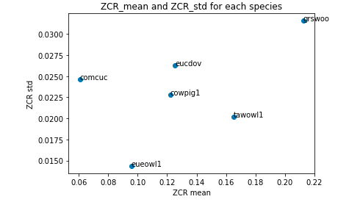
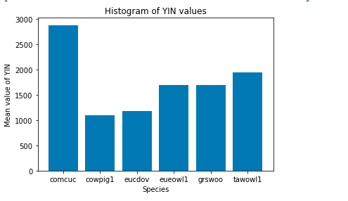
Feature characteristics
First step was to combine all the feature arrays of each species into one array
This was huge amount of data so we took the mean of each feature of a species’ array to down project it, so it gave us 6 arrays of 548 columns(features) which we then combined all into one array
We then worked with this 6x548 array to extract some important features
From the visualizations we can see how the ZCR_mean and ZCR_std are distributed by feature and also the YIN values – which was taken as the mean of the 14 yin values

Slide 5
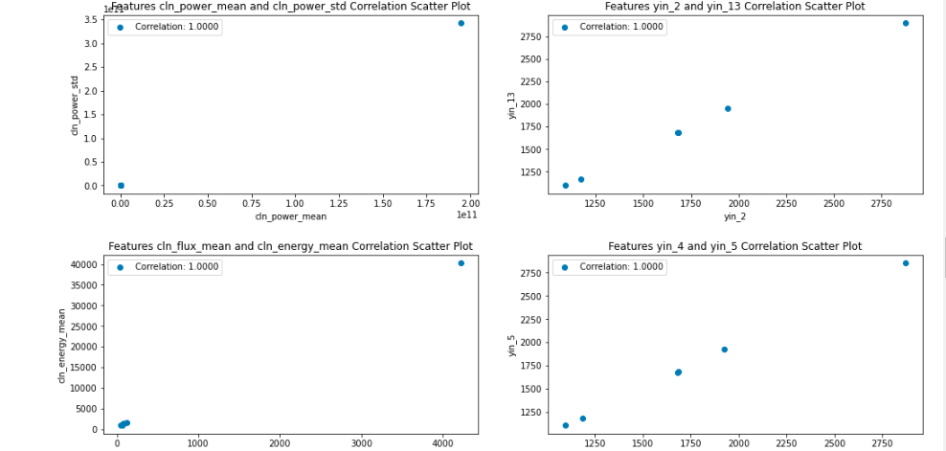
Feature characteristics
Regarding the correlation between features we used the Pearson correlation coefficient
We again worked with the mean array of features from before
The pairs of features that were most correlated were: cln_power_mean/cln_power_std, cln_flux_mean/cln_energy_mean, and the yin value

Slide 6
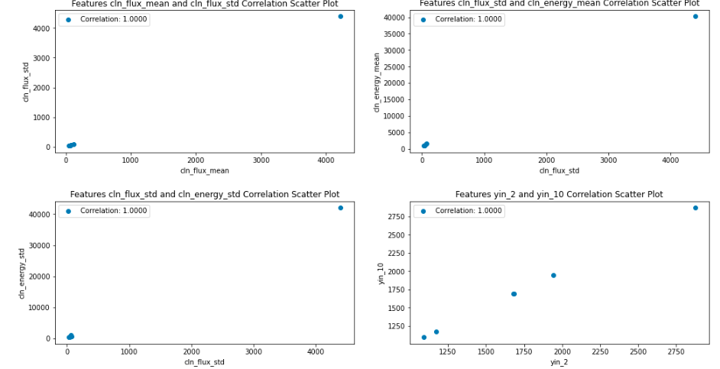
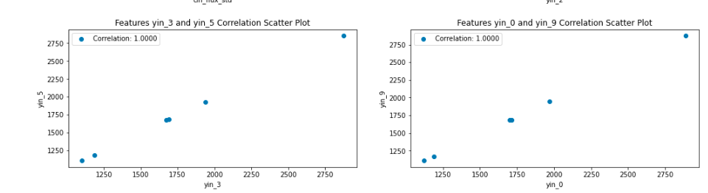

Slide 7
Feature/Label agreement
As seen from the previous visualizations the features ZCR_mean and ZCR_std seem useful for classification since they have distinct distributions for classification
Concerning the feature label correlation we can conclude that the features with a high Pearson correlation coefficient and labels with a high Cohen’s kappa coefficient can be useful moving forward for classification

Slide 8
Consequences
There is a moderate level of agreement among annotators for most of the species, which suggests that the annotations are reliable for classification-Some species are more dominant than other in the distribution which we need to take into account when for the classifier
Features like ZCR and YIN have distinctive distributions and could be useful
The data analysis showed that using raw and clean data is favorable and that they have similarities
Overall, the data analysis proved useful into gaining more insight on the data by getting its characteristics and investigating how the data could be used

